Slide 1


  CompTIA Security+
  Security Architecture Domain
  Stephen Reilly

Slide 2
    Introduction
# Welcome to this overview of Security+ certification Security Architecture Domain
# Current version: SY0-701 (released November 2023)
# Domain Weight: Security Architecture = 18% of total exam (~16 questions out of 90)
# Exam context: 90 questions in 90 minutes, mix of multiple-choice and performance-based items
# Why architecture matters: It’s the foundation for secure design, not just reactive security

Slide 3
    Domain Overview & Learning Objectives
# Nine sub-objectives (3.1–3.9):
# Architecture models (3.1)
# Virtualization & cloud security (3.2)
# Host/application/network/endpoint concepts (3.3)
# Secure network design (3.4)
# Secure system design (3.5)
# Secure application architecture (3.6)
# Secure protocols (3.7)
# Embedded/IoT/OT/mobile (3.8)
# AAA and access control models (3.9)

Slide 4
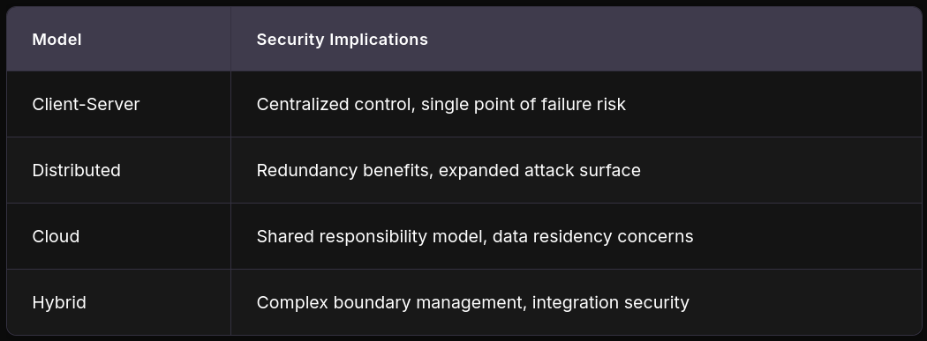
    Architecture Models Comparison
# Objective 3.1 – Compare and contrast architecture models:
# Key Concept: Shared responsibility in cloud, provider secures infrastructure; customer secures data/configurations

Slide 5
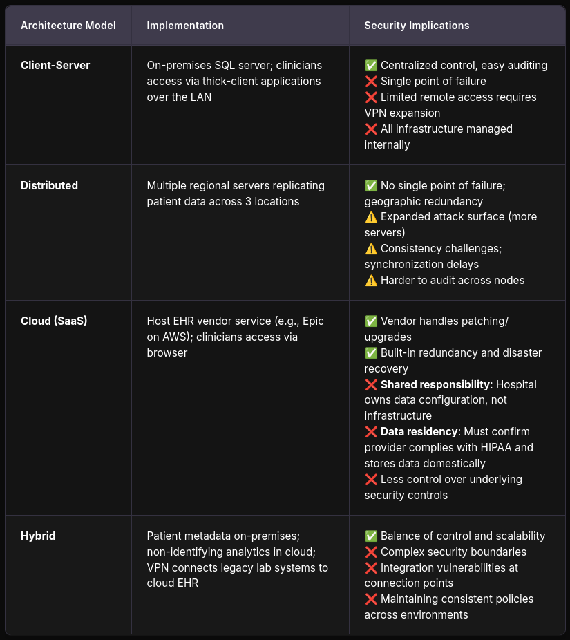
    Objective 3.1
    Real-World Examples:

Slide 6
    Virtualization & Cloud Security
# Objective 3.2 – Virtualization and cloud security concepts:
# Hypervisor Types: Type 1 (bare metal) vs. Type 2 (hosted). Type 1 has better security isolation
# Service Models:
IaaS: Customer manages OS, applications, data
PaaS: Customer manages applications and data only
SaaS: Provider manages almost everything; customer manages data and access
# Multi-tenant Isolation: Critical for cloud security; VM escape attacks
# Controls: Encryption at rest/in transit, secure APIs, Cloud Access Security Brokers (CASBs)

Slide 7
Objective 3.2 - Real-World Examples:
# VM Escape (Venom vulnerability, 2015): A flaw in QEMU's floppy disk controller allowed an attacker to escape a guest VM and execute code on the host—affected Type 2 hypervisors running unpatched QEMU. Demonstrates why patching the hypervisor layer itself is critical, and why Type 1 bare-metal hypervisors with minimal attack surfaces are preferred in production.
# Shared Responsibility in Practice: A company stores customer PII in AWS S3 buckets. AWS secures the physical infrastructure and the storage service itself, but the customer is responsible for bucket policies, IAM roles, and encryption settings. Misconfigured S3 buckets (public-read) have caused massive data breaches—Capital One (2019, 100M+ records) is a prime example where a misconfigured WAF allowed SSRF to access IAM credentials.
# CASB Use Case: An organization using Microsoft 365, Salesforce, and Google Workspace deploys a CASB to monitor shadow IT—discovering employees using unsanctioned file-sharing services, detecting anomalous data exfiltration patterns, and enforcing DLP policies across multiple SaaS platforms from a single pane of glass.

Slide 8
    Host, Application, Network & Endpoint Security
# Objective 3.3 – Security concepts across layers:
# Host Hardening: Patch management, disabling unnecessary services, secure configurations
# Host-Based Controls: Firewalls, HIPS, endpoint detection and response (EDR)
# Application Security: Input validation, allow-listing, secure SDLC practices
# Endpoint Security: Device encryption, remote wipe capabilities, mobile device management (MDM)

Slide 9
Objective 3.3 - Real-World Examples:
# Host Hardening – The Equifax Breach (2017): Attackers exploited Apache Struts CVE-2017-5638—a known vulnerability with a patch available for months. Equifax failed to apply the patch and lacked proper asset inventory to know which systems were affected. Lesson: patch management is only effective when paired with accurate asset discovery and vulnerability scanning.
# EDR in Action: An employee clicks a phishing link that downloads a PowerShell payload. Traditional AV might miss it since there's no known signature. EDR detects anomalous behavior—a Word document spawning PowerShell, which then makes outbound C2 connections—and alerts SOC analysts who isolate the endpoint before lateral movement occurs. Solutions like CrowdStrike Falcon or Microsoft Defender for Endpoint exemplify this.
# Application Allow-Listing: A hospital locks down clinical workstations using Windows AppLocker or WDAC, ensuring only approved medical applications run. When ransomware attempts to execute, it's blocked at the OS level—not relying on signature-based detection that may lag behind new variants.

Slide 10
    Secure Network Design
# Objective 3.4 – Network design concepts:
# Network Segmentation: VLANs, microsegmentation to limit lateral movement
# DMZ (Demilitarized Zone): Isolates public-facing services from internal network
# Defense-in-Depth: Layered security controls across network, host, application layers
# Zero Trust Architecture: "Never trust, always verify"—verify every request regardless of origin
# Secure Topologies: Perimeter security, bastion hosts, jump servers for admin access

Slide 11
Objective 3.4 - Real-World Examples:
# Segmentation Containing Ransomware: During the NotPetya attack (2017), organizations with flat networks saw the worm spread laterally across the entire enterprise within minutes. Companies with proper network segmentation—separating finance, HR, engineering, and production VLANs with strict ACLs—contained the damage to isolated segments. Maersk Shipping lost ~$300M; organizations with strong segmentation recovered much faster.
# Jump Server Architecture: A financial services firm requires all administrative access to production database servers to route through hardened jump boxes (bastion hosts) with multi-factor authentication, session recording, and privileged access management (PAM). No admin can SSH directly to a database server—the jump server acts as a choke point with full audit trail.
# Zero Trust at Scale: Google's BeyondCorp initiative moved away from traditional VPN perimeter security. Instead of trusting anyone inside the corporate network, every request is authenticated and authorized based on device posture, user identity, and context—regardless of network location. This has become the blueprint for modern zero-trust implementations.

Slide 12
    Secure System Design
# Objective 3.5 – System-level security:
# Trusted Computing Base (TCB): Hardware, software, and firmware enforcing security policy
# Hardware Security Modules:
TPM (Trusted Platform Module): Platform integrity, disk encryption keys
HSM (Hardware Security Module): Cryptographic key management, high-volume encryption
# Secure Boot: Verifies bootloader and OS kernel signatures before execution
# Virtualization-Based Security: Isolates security processes from main OS

Slide 13
Objective 3.5 - Real-World Examples:
# TPM + BitLocker: A laptop with a TPM chip has BitLocker full-disk encryption enabled. The encryption key is sealed inside the TPM and only released during a measured boot if platform integrity checks pass. If an attacker steals the laptop and removes the drive to read it on another machine, the data remains encrypted—the TPM won't release the key outside the original hardware context.
# HSM in Banking: A payment processing company handles millions of card transactions daily. HSMs (like Thales Luna or AWS CloudHSM) perform PIN verification, card data encryption, and key rotation at hardware speed. Keys never leave the HSM in plaintext—even application code can only submit operations, not extract keys. This satisfies PCI-DSS (Payment Card Industry Data Security Standard) requirements for cryptographic key protection.
# Secure Boot Preventing Rootkits: A Linux server with UEFI Secure Boot enabled verifies the bootloader signature before loading the kernel. If an attacker gains root access and tries to install a kernel-level rootkit (modifying the bootloader or kernel image), the system refuses to boot—breaking the chain of trust. Bootloader-level malware like Lojax (a UEFI rootkit attributed to APT28/Fancy Bear) exploits precisely this gap when Secure Boot is disabled.

Slide 14
    Secure Application Architecture
# Objective 3.6 – Application security:
# Secure SDLC: Security integrated throughout development lifecycle
# Input Validation: Prevent injection attacks
# Secure Coding Practices: Parameterized queries, output encoding, error handling
# Container Security: Image scanning, minimal base images, runtime security
# Application Allow-Lists: Only approved applications execute

Slide 15
Objective 3.6 - Real-World Examples:
# SQL Injection (Still #1 on OWASP): A retail web application accepts user search input and concatenates it directly into a SQL query. An attacker inputs ' OR '1'='1 in the search box, extracting the entire customer database. The fix: parameterized queries (PreparedStatement) that separate SQL structure from user input entirely. Equifax's breach (mentioned earlier) also involved application-level exploitation.
# Container Security Pipeline: A DevOps team uses Docker/Kubernetes. Their CI/CD pipeline includes Trivy or Clair to scan container images for known CVEs before deployment. Base images are pulled from Distroless or Alpine (minimal attack surface) rather than full Ubuntu images. Runtime security tools like Falco monitor for anomalous container behavior (e.g., a web container spawning a shell—classic indicator of compromise).
# Secure SDLC – Shift Left: A SaaS company integrates SAST (Static Application Security Testing) into developers' IDEs, runs DAST scans in staging, and requires security review of dependencies (SCA) before any pull request merges. Finding a vulnerable dependency at commit time costs minutes; finding it in production after a breach costs millions. Capital One's breach involved a known-vulnerable dependency.

Slide 16
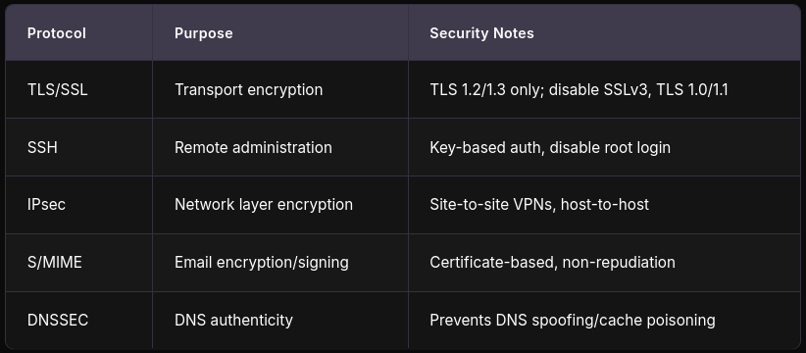
    Secure Protocols
# Objective 3.7 – Protocol security:

Slide 17
Objective 3.7 - Real-World Examples:
# TLS Misconfiguration – Heartbleed (2014): OpenSSL CVE-2014-0160 allowed attackers to read server memory (including private keys) by exploiting a bounds-checking flaw in TLS heartbeat extension. Millions of servers were affected. Lesson: protocol security isn't just about which version you enable—it's also about keeping implementations patched and disabling unnecessary extensions.
# SSH Key Hygiene: An engineering team discovers an administrator's SSH private key was committed to a public GitHub repository 8 months ago. All servers that accepted that key are compromised. Best practice: rotate keys regularly, use SSH certificates (not raw keys), enforce key-based auth only, disable password auth, and implement centralized key management (e.g., Teleport or HashiCorp Vault SSH secrets engine).
# DNSSEC Preventing Cache Poisoning: Without DNSSEC, an attacker can poison a DNS resolver's cache—redirecting users from bank.com to a phishing site with a forged DNS response. DNSSEC signs DNS records cryptographically, allowing resolvers to verify authenticity. The .gov TLD mandates DNSSEC; financial institutions increasingly require it for their domains.

Slide 18
    Embedded, IoT, OT & Mobile
# Objective 3.8 – Specialized device considerations:
# Embedded Systems: Limited compute; firmware signing, secure boot critical
# IoT Devices: Default credentials, unencrypted comms, difficult to patch
# Operational Technology (OT): Legacy systems, safety-critical, air-gapping
# Mobile/BYOD: Containerization, MDM policies, remote wipe

Slide 19
Objective 3.8 - Real-World Examples:
# IoT Botnet – Mirai (2016): Mirai malware scanned the internet for IoT devices (IP cameras, DVRs, routers) using default factory credentials like admin/admin. It conscripted hundreds of thousands of devices into a botnet that took down Dyn DNS, crippling Twitter, Netflix, and Reddit for hours. It demonstrates why default credential changes and network isolation for IoT are non-negotiable.
# OT/ICS Attack – Triton/Trisis (2017): Attackers compromised a Saudi petrochemical plant's Safety Instrumented System (SIS), attempting to disable safety controls that would have prevented a catastrophic release of toxic gas. Unlike IT systems, OT attacks can cause physical harm and loss of life. This is why OT networks are air-gapped or heavily segmented from IT networks, with unidirectional gateways for data diodes.
# BYOD Done Right: A consulting firm allows employees to use personal phones for work email and documents. Using MDM (Mobile Device Management, like Microsoft Intune), the company creates a separate encrypted container on the device for corporate data. If an employee leaves or a device is lost, the company remotely wipes only the corporate container—personal photos and apps remain untouched. Privacy is maintained for the user while security is maintained for the organization.

Slide 20
    Authentication, Authorization & Accounting
# Objective 3.9 – AAA and access control:
# IAM: Centralized identity lifecycle management
# Authentication Factors: Something you know/have/are—MFA mandatory for privileged access
# Single Sign-On (SSO): Reduce credential fatigue; SAML (Security Assertion Markup Language), OIDC (OpenID Connect, built on top of Oauth 2.0) protocols
# Federated Identity: Cross-organization trust relationships
# Access Control Models: RBAC, ABAC, Least Privilege

Slide 21
Objective 3.9 - Real-World Examples:
# MFA Stopping Account Takeover: A phishing campaign targets an organization's Office 365 users. Employees enter credentials on a convincing fake login page. The attackers capture passwords and attempt login—but Microsoft Entra ID requires a second factor (authenticator app push). Even with valid passwords, the attackers can't complete authentication. Microsoft reports MFA blocks 99.9% of automated account attacks.
# RBAC vs. ABAC in Practice: A healthcare organization initially implements RBAC—doctors can access patient records, nurses can access medication charts, administrators handle billing. But this proves too rigid: a traveling nurse needs access to records at multiple facilities, and doctors shouldn't see VIP patient records without authorization. They evolve to ABAC, where access decisions incorporate attributes: role=nurse AND facility=current_location AND patient_clearance <= staff_clearance.
# Federated Identity – University Scenario: A university partners with a cloud research platform. Students and faculty authenticate using their university credentials via SAML/Shibboleth federation—no separate accounts needed. When a student graduates, their university identity is deactivated, and they automatically lose access to the research platform. No manual deprovisioning required—identity lifecycle is managed at the source.
# Least Privilege Failure: A junior developer is granted temporary AdministratorAccess on an AWS account to debug an issue. The temporary access is never revoked. Months later, their access key is leaked via a misconfigured .env file in a public repo. An attacker uses it to spin up cryptomining instances, costing $50,000 in compute. Lesson: time-bound privileged access with automatic expiration (e.g., AWS IAM temporary STS tokens, or PAM solutions like CyberArk).

Slide 22
    Key Security Design Principles
# Least Privilege: Users/systems get minimum access required
# Defense-in-Depth: Multiple overlapping security layers
# Fail-Safe Defaults: Systems default to secure state on failure
# Economy of Mechanism: Simple, verifiable security designs
# Complete Mediation: Every access request checked, not just initial login

Slide 23
    Common Pitfalls & Exam Tips
# Study Traps to Avoid:
# Confusing IaaS/PaaS/SaaS responsibilities
# Mixing up hypervisor types
# Not distinguishing between network-layer vs. application-layer controls
# Overlooking shared responsibility in cloud contexts

Slide 24
    Conclusion & Resources
# Security Architecture comprises 18% of SY0-701
# Strong foundation needed for operations and management domains
# Official resources:
# CompTIA Security+ Exam Objectives (SY0-701): https://www.comptia.org/certifications/security
# Practice exams and hands-on labs recommended
# Questions?

